Slide 1
ImageJ/FIJI image processing basics
Dr. Dominic Alibhai & Dr. Stephen Cross

Slide 2
Overview
Brief Introduction to image acquisition and basic image processing techniques
Hands on image processing with Fiji/ImageJ
Step by step guide to different image processing concepts in Fiji
Exercises for you to complete on each section
Useful Websites for further reading:
https://www.microscopyu.com/
https://svi.nl/AboutMicroscopy
http://zeiss-campus.magnet.fsu.edu/tutorials/
http://www.leica-microsystems.com/science-lab/
https://imagej.nih.gov/ij/docs/guide/user-guide.pdf

Slide 3
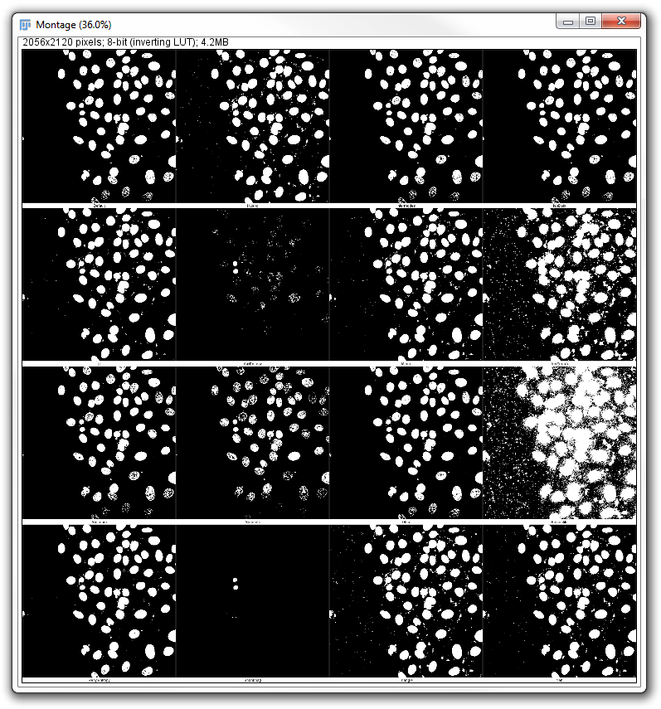
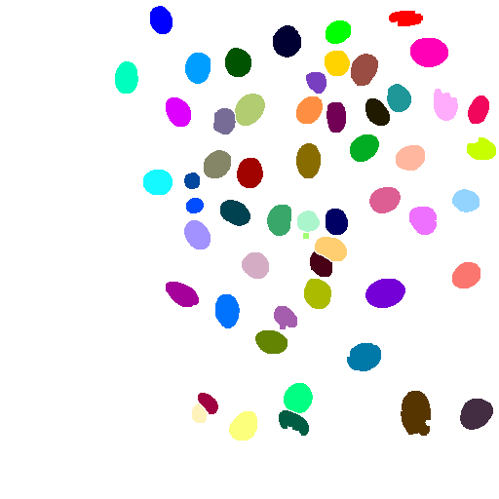
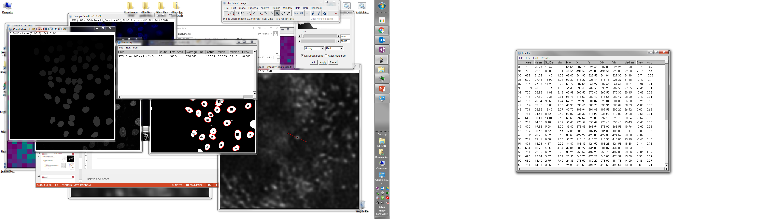
Overview
Raw data + pre-processing
Image processing + segmentation
Object identification
Quantification

Slide 4

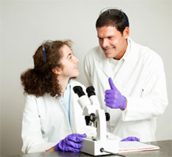

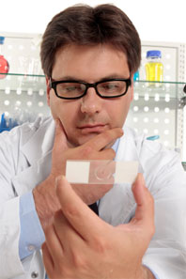

Experimental Steps
Quantification
Segmentation
Visualisation
Acquisition
Sample prep
Notes:
Good analysis requires good samples acquired properly
Crap in → crap out

Slide 5
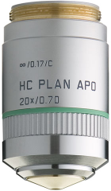
Objectives, Numerical Aperture and Resolution
$$NA=n\sin\left(θ\right)$$
F
θ
$$r_{xy}= \frac{0.61λ}{n\sin\left(θ\right)}=\frac{0.61λ}{NA}$$
D
$$r_{z}\sim 2.5r_{xy}$$
Resolution is the minimum distance between two points which allows them to be distinguished as individual objects
It is the NA of the objective which determines the resolution - not the magnification
Notes:
In Camera Systems need to balance mag with NA as fixed camera pixel size to get best resolution

Slide 6
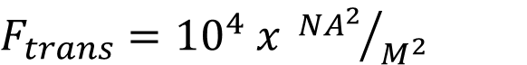
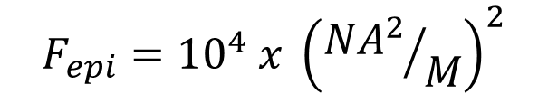
Magnification and image brightness
Correction | Magnification | Numerical Aperture | F(trans) | F(epi)
Plan Achromat | 10x | 0.25 | 6.25 | 0.39
Plan Apo | 10x | 0.45 | 20.2 | 4.10
Plan Fluorite | 20x | 0.50 | 6.25 | 1.56
Plan Apo | 20x | 0.75 | 14.0 | 7.90
Plan Achromat | 40x | 0.65 | 2.64 | 1.11
Plan Apo | 40x (oil) | 1.30 | 11.0 | 18.0
Plan Fluorite | 60x | 0.85 | 2.01 | 1.45
Plan Apo | 60x (oil) | 1.40 | 5.4 | 10.6
Plan Apo | 100x (oil) | 1.40 | 1.96 | 3.84
Plan Apo | 100x (oil) | 1.45 | 2.10 | 4.42
For a given NA, lower magnification gives a brighter image
Notes:
Camera systems -> need to balance light throughput with pixel size

Slide 7
Bit Depth and digital images
20 | 24 | 31 | 38 | 39 | 43 | 40 | 39 | 41 | 39 | 45 | 44 | 43 | 40 | 35 | 26 | 23 | 21 | 16 | 15 | 12 | 15 | 10 | 9
24 | 27 | 31 | 33 | 39 | 36 | 41 | 38 | 39 | 40 | 42 | 45 | 43 | 44 | 34 | 29 | 27 | 22 | 17 | 14 | 13 | 11 | 8 | 10
25 | 25 | 31 | 37 | 41 | 41 | 41 | 41 | 37 | 36 | 36 | 45 | 43 | 40 | 39 | 33 | 27 | 23 | 15 | 16 | 15 | 13 | 12 | 13
20 | 25 | 24 | 36 | 39 | 38 | 41 | 37 | 39 | 39 | 38 | 39 | 43 | 37 | 39 | 35 | 30 | 24 | 20 | 19 | 12 | 14 | 13 | 11
24 | 25 | 29 | 36 | 35 | 39 | 37 | 39 | 38 | 37 | 38 | 42 | 41 | 42 | 42 | 38 | 37 | 27 | 26 | 23 | 19 | 17 | 17 | 15
27 | 24 | 32 | 38 | 37 | 42 | 37 | 39 | 41 | 41 | 35 | 41 | 38 | 48 | 42 | 40 | 36 | 31 | 29 | 26 | 20 | 20 | 17 | 19
26 | 25 | 31 | 32 | 32 | 38 | 40 | 37 | 38 | 35 | 40 | 39 | 40 | 46 | 40 | 39 | 38 | 41 | 35 | 28 | 27 | 24 | 19 | 20
27 | 22 | 32 | 35 | 38 | 34 | 38 | 40 | 37 | 39 | 40 | 41 | 37 | 37 | 38 | 43 | 43 | 41 | 38 | 36 | 31 | 30 | 27 | 25
24 | 30 | 30 | 40 | 40 | 40 | 39 | 36 | 41 | 34 | 39 | 40 | 40 | 40 | 41 | 42 | 42 | 44 | 42 | 42 | 37 | 36 | 33 | 37
28 | 34 | 37 | 41 | 41 | 40 | 43 | 38 | 41 | 42 | 40 | 37 | 35 | 35 | 40 | 37 | 39 | 41 | 42 | 41 | 42 | 42 | 40 | 40
31 | 35 | 41 | 40 | 42 | 44 | 45 | 46 | 43 | 37 | 42 | 39 | 36 | 39 | 39 | 38 | 41 | 39 | 40 | 38 | 45 | 42 | 42 | 41
34 | 38 | 40 | 42 | 41 | 44 | 44 | 48 | 47 | 41 | 43 | 38 | 39 | 39 | 37 | 39 | 39 | 39 | 39 | 37 | 42 | 44 | 40 | 39
38 | 41 | 41 | 47 | 46 | 49 | 46 | 44 | 47 | 42 | 39 | 41 | 36 | 39 | 36 | 38 | 36 | 35 | 39 | 37 | 37 | 39 | 42 | 41
42 | 48 | 47 | 45 | 50 | 49 | 46 | 46 | 46 | 50 | 48 | 47 | 40 | 35 | 36 | 40 | 37 | 39 | 36 | 40 | 37 | 36 | 37 | 41
44 | 45 | 54 | 52 | 54 | 48 | 50 | 45 | 47 | 44 | 47 | 43 | 50 | 41 | 41 | 36 | 38 | 36 | 41 | 39 | 37 | 37 | 37 | 37
44 | 47 | 47 | 55 | 49 | 50 | 48 | 51 | 46 | 44 | 44 | 45 | 47 | 45 | 40 | 43 | 36 | 40 | 36 | 36 | 36 | 32 | 37 | 39
43 | 46 | 50 | 51 | 54 | 52 | 50 | 48 | 47 | 47 | 51 | 46 | 42 | 41 | 42 | 41 | 41 | 39 | 38 | 38 | 38 | 39 | 38 | 40
45 | 50 | 50 | 47 | 43 | 48 | 44 | 45 | 50 | 45 | 45 | 44 | 48 | 44 | 43 | 43 | 43 | 40 | 41 | 34 | 35 | 38 | 40 | 38
46 | 45 | 43 | 42 | 34 | 38 | 36 | 41 | 42 | 43 | 44 | 43 | 42 | 44 | 51 | 48 | 43 | 41 | 41 | 38 | 36 | 39 | 35 | 39
41 | 39 | 39 | 35 | 35 | 29 | 29 | 32 | 33 | 36 | 39 | 37 | 44 | 43 | 46 | 43 | 43 | 43 | 39 | 40 | 39 | 39 | 41 | 39
38 | 30 | 34 | 29 | 28 | 29 | 27 | 26 | 28 | 32 | 33 | 38 | 42 | 42 | 44 | 44 | 45 | 48 | 39 | 43 | 40 | 45 | 39 | 43
29 | 30 | 29 | 24 | 24 | 23 | 27 | 29 | 25 | 28 | 30 | 38 | 33 | 40 | 43 | 43 | 46 | 44 | 46 | 46 | 42 | 42 | 46 | 42
26 | 24 | 25 | 23 | 22 | 21 | 26 | 25 | 23 | 28 | 28 | 29 | 35 | 41 | 39 | 42 | 41 | 43 | 48 | 48 | 44 | 45 | 46 | 40
25 | 24 | 22 | 22 | 20 | 22 | 17 | 19 | 23 | 23 | 25 | 27 | 32 | 36 | 40 | 41 | 49 | 46 | 40 | 48 | 47 | 43 | 48 | 44
1 bit | 2¹ | 2
8 bit | 2⁸ | 256
12 bit | 2¹² | 4096
16 bit | 2¹⁶ | 65536

Slide 8
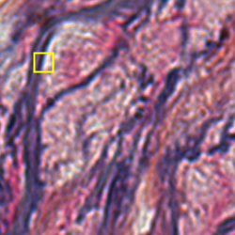

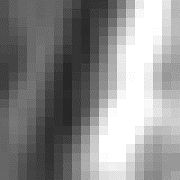

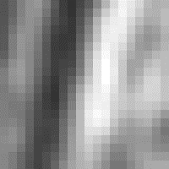
RGB Images
Red
Green
Blue
RGB images are made up of 3 x 8-bit images - One ‘Red’, one ‘Green’ and one ‘Blue’
An RGB image therefore contains 3 values per pixel representing the intensity of each of the 3 colours.
For analysis, RGB images can be split into the constituent channels, or kept as RGB depending on the analysis performed.

Slide 9
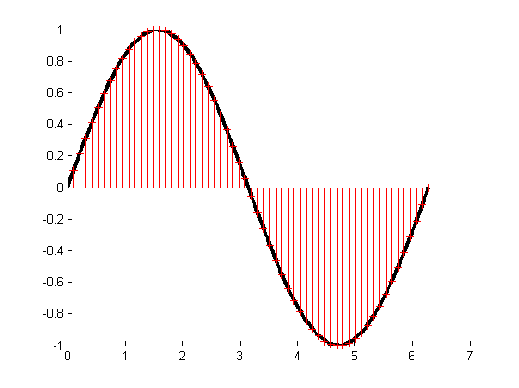
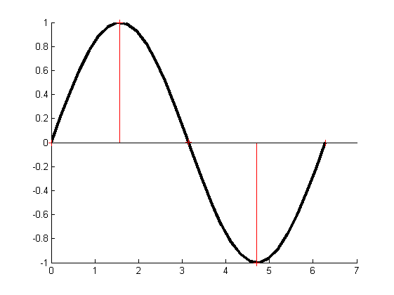
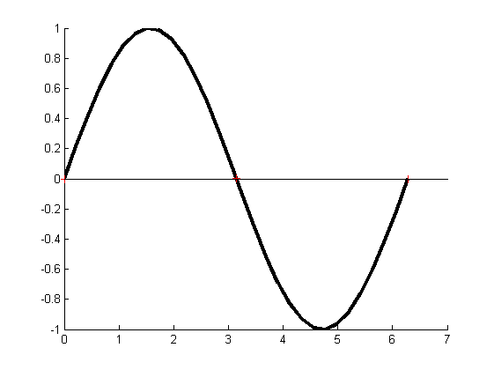
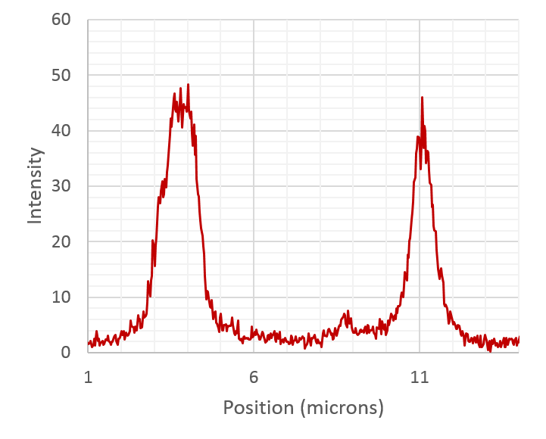
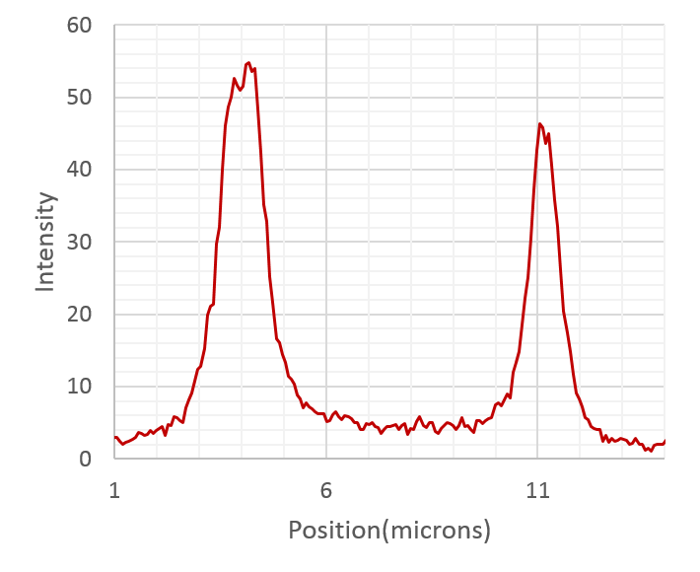
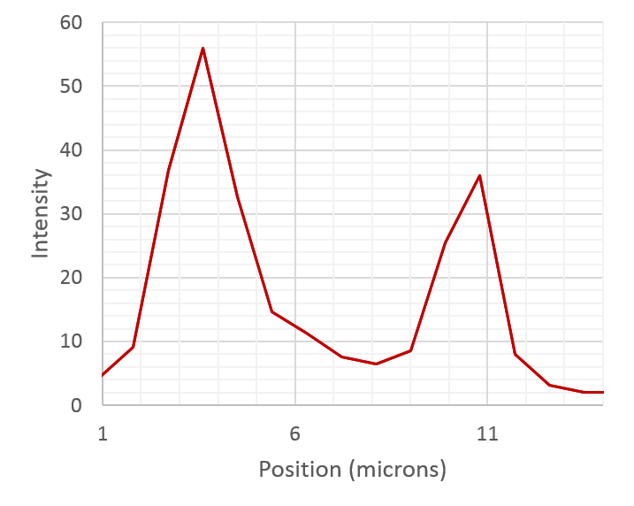
Sampling an image
Oversampled
Not ‘bad’ but will take longer and cause more photodamage to the sample
Nyquist sampled
Minimum sampling rate to capture the signal
Under sampled
Aliasing
Notes:
Sampling of image just like sampling other things e.g. converting music from analogue to digital

Slide 10

Sampling an image
Smaller features in image correspond to higher spatial frequencies
When setting pixel size (in confocal), important to sample image appropriately to avoid aliasing in image.
Rule of Thumb:
Not always possible due to photobleaching etc.
Need to be aware of roughly the smallest feature you are interested in.
http://svi.nl/NyquistRate - lots of information on Nyquist sampling + Nyquist calculator! http://svi.nl/NyquistCalculator
Notes:
Recommend registering with SVI for more useful info
SVI uses frequency bandwidth to calculate nyquist rate (fourier transform of psf =optical transfer function) which is smaller than ‘rule of thumb’ -> for airy1 pinhole can use sampling slightly larger than svi recommendation

Slide 11
Image Processing
Improve the signal to noise of the image
Background subtraction
Filtering
Segment and measure features within the image
Size
Shape - Circularity/ellipticity etc.
Intensity – per channel or ratio
Tracking
Changes over time
Changes after stimulation etc.

Slide 12
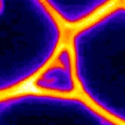
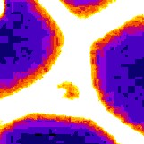
File Types
TIFF – good general choice
Lossless storage
Header tags for metadata
Multipage compatible (i.e. stacks, multicolour, tile scanning etc.)
Proprietary formats (e.g. .lif) – most complete
Lossless storage
(Should!) Contain all metadata
Readers required for viewing outside proprietary software
PNG – good for transfer/display
Lossless compression
RGB only
No associated metadata
JPEG – ….just don’t…

Slide 13
Image Types
2D
XY
3D
XYT
XYC
XYZ
Hyperstacking (4,5,6,7…D)
XYZT
XYZCT

Slide 14
Histograms & Thresholds
Histogram of image shows probability density function of intensity values
Range of intensity values determined by bit depth of image
Thresholding separates foreground (objects of interest) from background
Various algorithms available in FIJI:
Otsu (default)
Li
Percentile
…
Each will give different results
Doesn’t really matter which one you pick!
Threshold
Frequency
0
Intensity
255

Slide 15
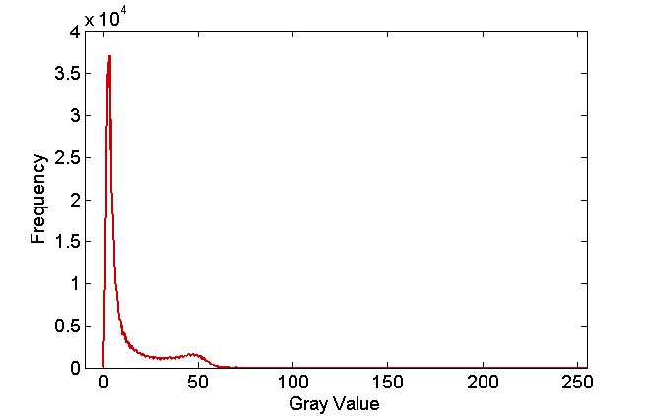
Binary Images
1 bit | 2¹ | 2
8 bit | 2⁸ | 256
12 bit | 2¹² | 4096
16 bit | 2¹⁶ | 65536
Binary image formed of 0’s and 1’s – background and objects
Use threshold value calculated from histogram to determine cut-off intensity
Otsu threshold used – threshold = 23

Slide 16
Filtering Images
Spatial Filter:
Image operation where each pixel value I(u,v) is changed by a function of the intensities of pixels in the neighbourhood of (u,v).
Example: Mean filter in 3 x 3 neighbourhood
u₋₁
u
u₊₁
u
u
I
I’
v₋₁
v
v₊₁
v
v
$$I^{′}=\frac{1}{9}\sum_{i=−1}^{1}{\sum_{j=−1}^{1}{I\left(u+i, v+j\right)}}$$
I(u,v)
I’(u,v)

Slide 17
Filtering Images
Applying filters:
Raster scan processing kernel across image
1
1
1
$$\frac{1}{9} x$$
1
1
1
1
1
1
3 x 3 Mean kernel

Slide 18
Filtering images
No Filter
Gaussian (r=2)
Median (r=2)
Sobel Edge Detection
Notes:
Although I use jpeg in this course!

Slide 20
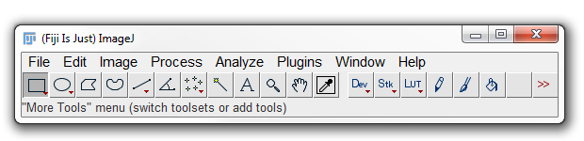
ImageJ/Fiji interface
File open/save
Copy/paste, invert image intensity, regions of interest
Stack operations, scale, crop, zoom, rename, LUTs
Filter, binarise, add/subtract images, subtract background
Measurement, analyse particles, intensity profiles, colocalisation
Downloaded plugins (many installed with Fiji)
System messages, pixel coordinates, pixel intensity
Region selection
Zoom/pan
LUTs

Slide 21
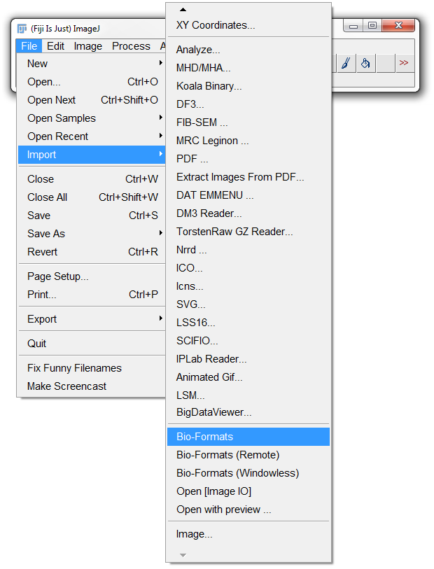
Loading images
Load standard images using “Open”
File > Open
To load image sequences
Files ending in “0001.tif”, “0002.tif”, etc.
File > Import > Image Sequence…
Load Leica (.lif) files using Bio-Formats
File > Import > Bio-Formats
Included with FIJI (download for ImageJ)

Slide 22
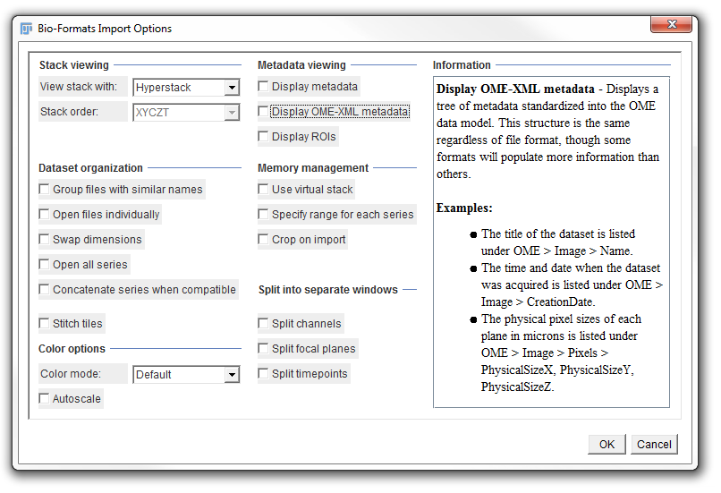
Loading images
Display OME-XML metadata
Shows formatted metadata
Microscope and image acquisition settings (laser power, objective lens, etc.)
Use virtual stack
Images loaded directly from storage (not loaded to RAM in advance)
Useful for large files (>1GB)

Slide 23
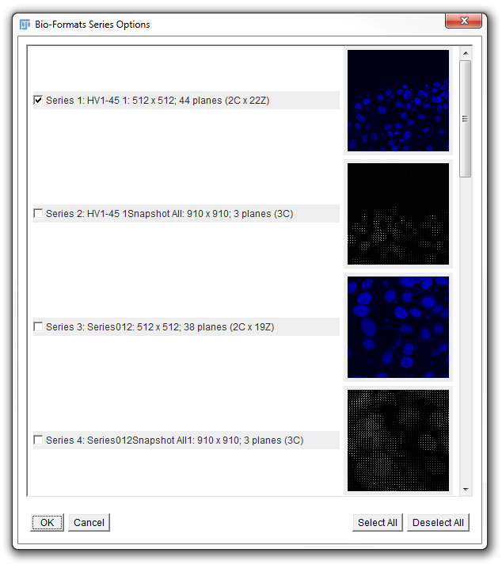
Loading images
Select relevant images
Only shows up when >1 image stack in file

Slide 24
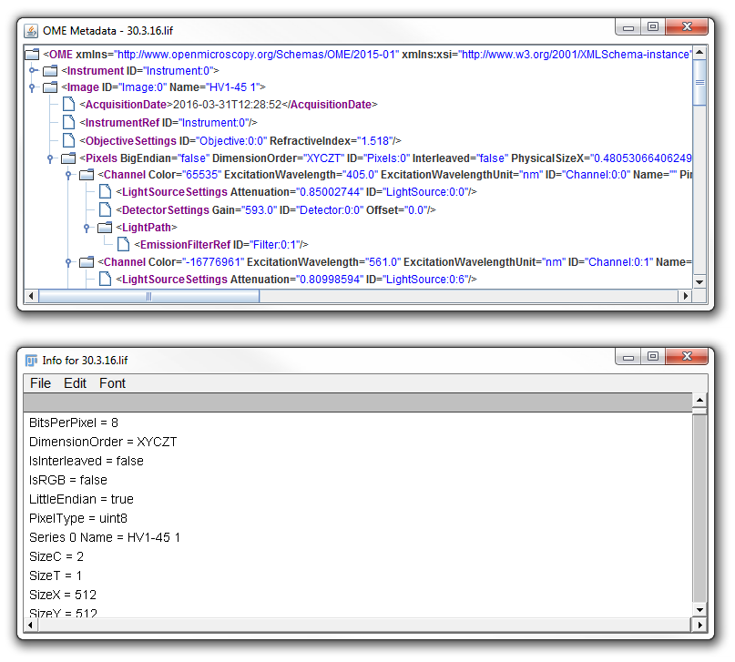
Image metadata
OME-XML metadata
Loaded via Bio-Formats
Easier to read
Show info
Image > Show Info…
Plain text format
Works for any image (content will vary)
Shows more information than OME-XML

Slide 25
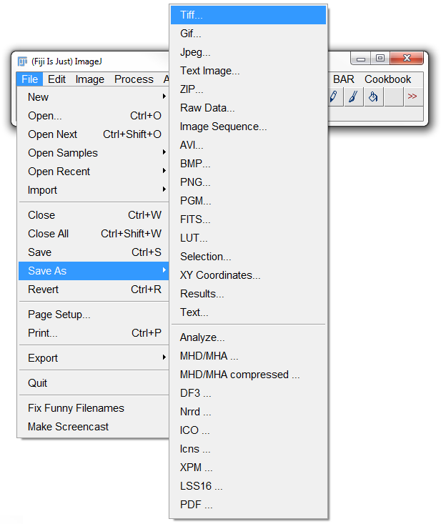
Saving images
Save images to single .tif file
File > Save As > Tiff…
Save image sequence
File > Save As > Image Sequence…
Each slice saved as a separate .tif file
Filenames end with “0001.tif”, “0002.tif”, etc.
Number of zeroes dictated by “Digits” option

Slide 26
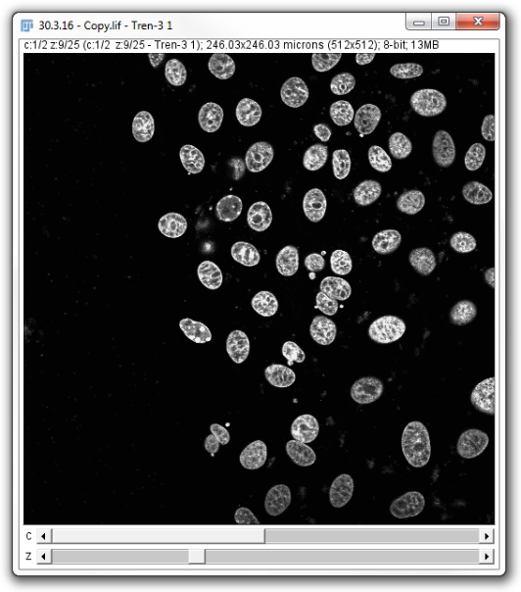
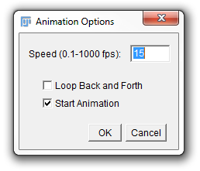
Image navigation
Move through frames using sliders
Channel (C)
Blue, red, etc.
Z-slice (Z)
Time ()
Click  to play video
Change video speed
Image > Stacks > Animation > Animation options
Thanks to Joe Wrennall for confocal images

Slide 27
Worksheet – section 1
Aims
Loading an image with BioFormats
Selecting channels and slices with sliders
Notes
Download “ExampleData.lif” from https://goo.gl/YrBvRU
Notes:
45 minutes
Wait 5 minutes
15:00

Slide 28
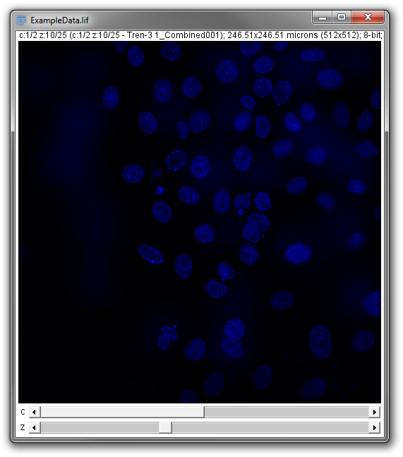
Worksheet – section 1

Slide 29
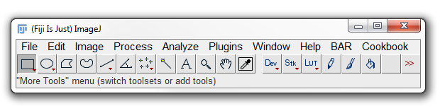
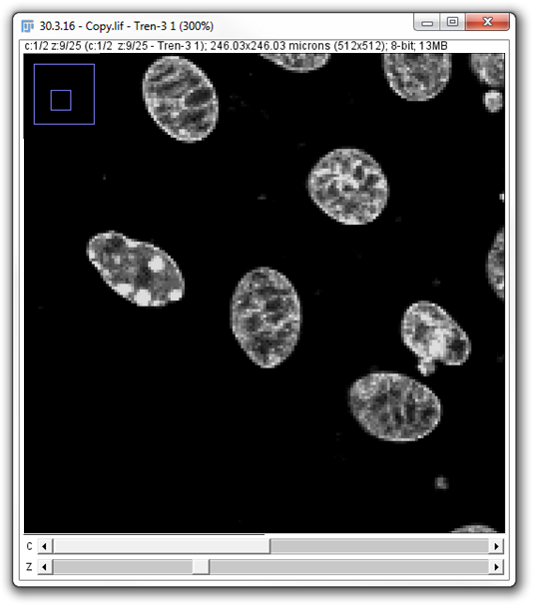
Image navigation
Zooming
Select
Left click to zoom in, right click to zoom out
Can also zoom with up/down keys on keyboard
Dragging
Select
Click and hold to drag
Position in image shown in top-left
Zoom
Drag

Slide 30
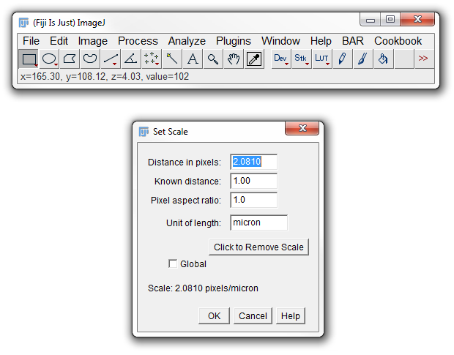
Image navigation
Pixel coordinates
Move the cursor over the image
Coordinates and intensity displayed in main ImageJ/FIJI window
If distance per pixel known, position shown in that scale, otherwise shown in pixel units
Calibration automatically loaded if available
Manually setting distance per pixel
Analyze > Set Scale…

Slide 31
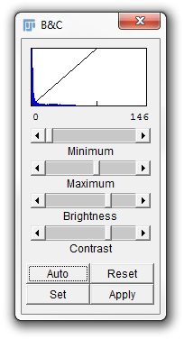
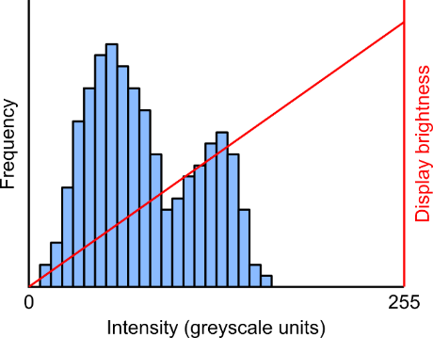

Brightness and contrast
Adjust how intensity is displayed
Image > Adjust > Brightness/Contrast…
By default 0 intensity is displayed as black and 255 (8-bit) as white
Use min and max sliders to change display range
Image intensity values are unchanged
Alter intensity values (optional)
Clicking “Apply” rescales intensity values to 0-255
Treat this function with care
Notes:
It’s this reason 16-bit images can look entirely black when opened in Windows.

Slide 32
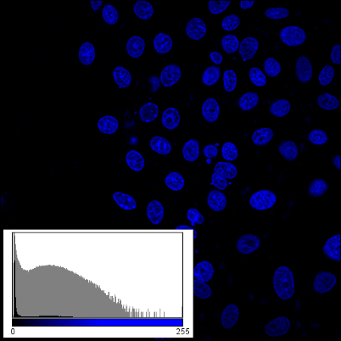
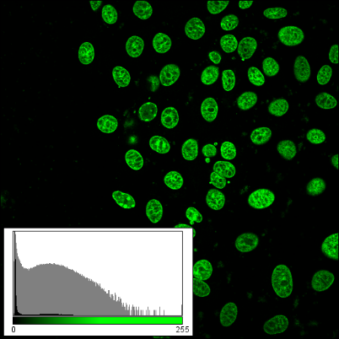
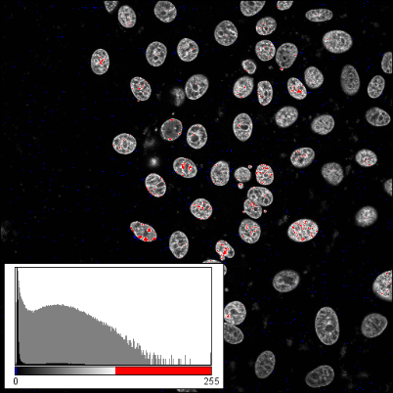
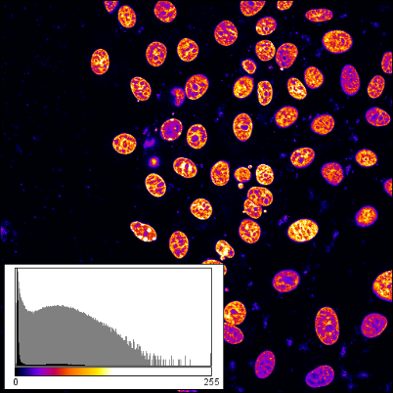
Lookup table (LUT)
Microscope images generally greyscale
No colour information
Colour determined by LUT
Image data not altered by LUT

Slide 33
Worksheet – section 2
Aims
Adjusting appearance of image with Brightness/Contrast
Changing lookup table (LUTs)
Using zoom and pan tools
Notes:
45 minutes
Wait 5 minutes
15:00

Slide 34
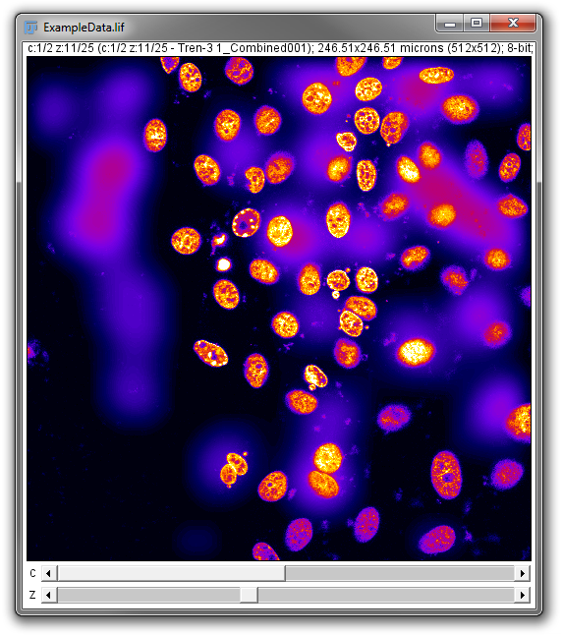
Worksheet – section 2

Slide 35
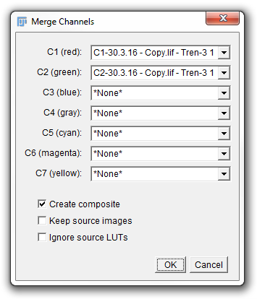
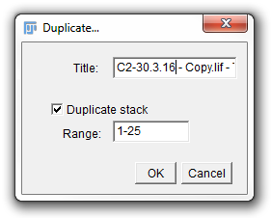
Stack manipulation
Split channels
Image > Color > Split channels
Merge channels
Image > Color > Merge channels…
Duplicate stack
Image > Duplicate
Can duplicate individual slices or whole stack

Slide 36
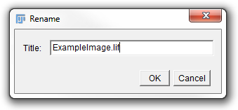
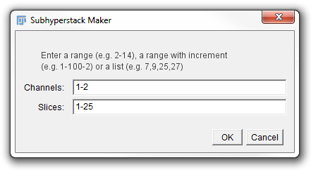
Stack manipulation
Rename stack
Image > Rename
Extract single slices from stack
Image > Stacks > Tools > Make Substack…
Enter single channel/slice numbers or ranges

Slide 37
Intensity projections
Max intensity
Project stack to single plane
Image > Stacks > Z Project…
Max Intensity: Highlights signal
Min intensity: Good for identifying constant background
Also available: mean, median, sum and standard deviation
Min intensity
Mean intensity
Intensity standard dev.

Slide 38
Worksheet – section 3
Aims
Split two channels of input image
Discard the cell image (channel 2)
Compare approaches for extracting “good example images of nuclei”
One image from a Z-projection
One image from a single Z-slice
Notes:
45 minutes
Wait 5 minutes
15:00

Slide 39
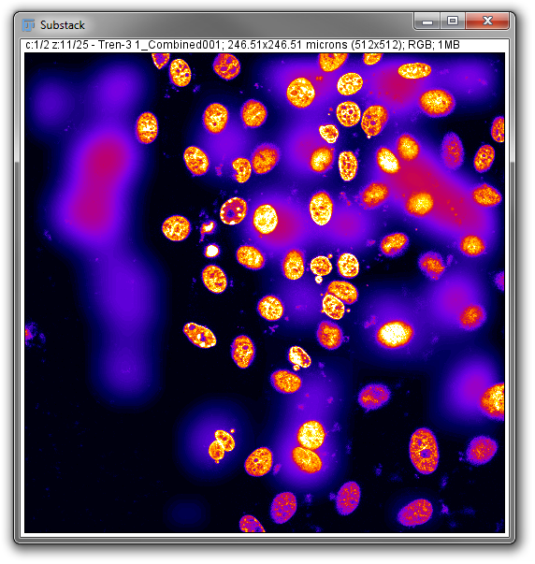
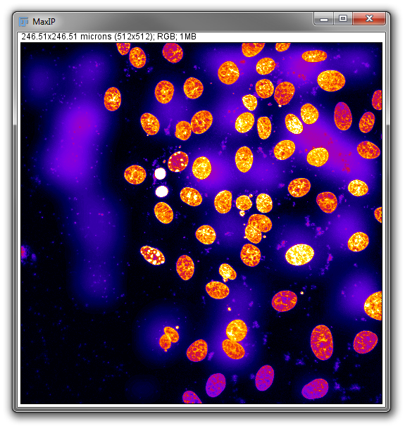
Worksheet – section 3
Substack
Max. intensity Z-projection

Slide 40
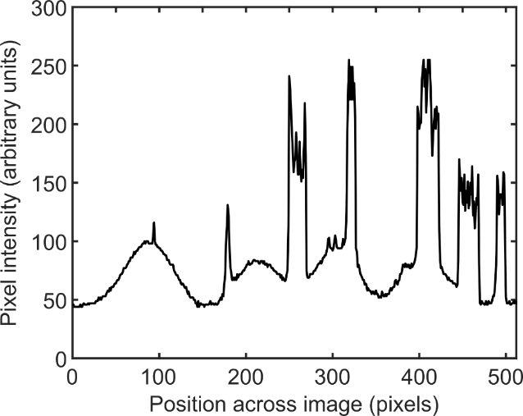
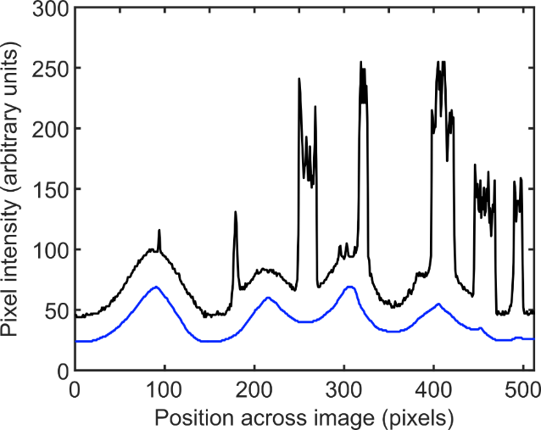
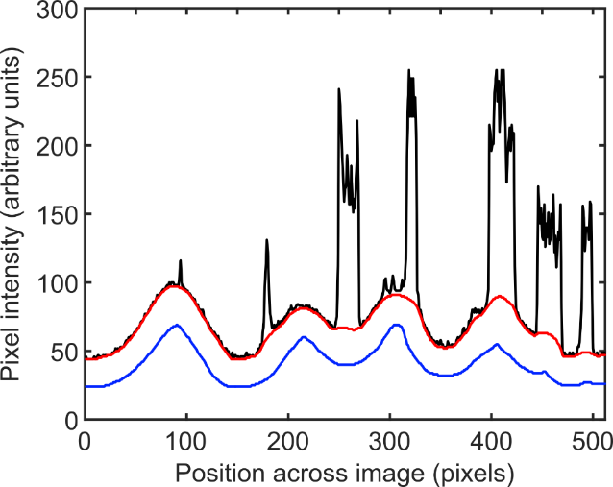
Background subtraction
Rolling ball
Passes a ball underneath the image
The ball traces out features larger than its own diameter (i.e. the background)
Repeat from opposite side to remove effect of ball radius

Slide 41
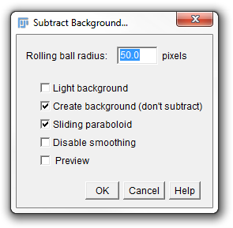
Background subtraction
Rolling ball
Process > Subtract Background…
Tick “Create background” to get background image
“Sliding paraboloid” replaces the ball with a parabola and can give better results
Rolling ball
Sliding paraboloid

Slide 42
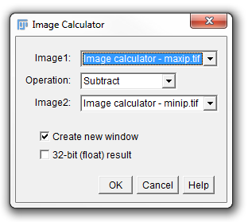
Image calculator
Image A (signal)
Add/subtract images
Process > Image Calculator…
Calculated pixel-by-pixel
“32-bit (float) result” when negative or non-integer values may occur
Image B (background)
Image C (result)

Slide 43
Worksheet – section 4
Aims
Use two approaches to subtract background
Rolling ball subtraction
Minimum intensity projection subtraction
Apply both subtraction methods to nuclei image from exercise 3
Duplicate image first, then apply subtraction
End up with two images for comparison

Slide 44


Worksheet – section 4
Rolling ball subtraction
Minimum intensity Z-projection subtraction

Slide 45






Selecting regions
Hand-drawing tools to select regions
Right click for more options (red arrow)
Can drag handles to reshape afterwards
Polygon selection
Close loop to finish (small square)
Line tools
Don’t need to enclose area

Slide 46


Selecting regions
Automatic region selection using wand tool
Selects contiguous pixel regions with similar intensities
Double click icon to get more options
Tolerance sets permitted intensity variation

Slide 47

Making measurements
Setting measurements
Analyze > Set Measurements…
“Redirect to” uses the regions from a binary image on a different image
Making measurements
Analyze > Measure

Slide 48


Results table
Lists measurement output
One measurement per row
Extra options when window is called “Results”
“Summarize” gives mean, SD, etc. of all columns
“Distribution” creates histogram of one column
“Sort” organises data based on one column
“Plot” creates XY plot of two columns

Slide 49

Linear intensity profile
Draw line on image
Straight, freehand, segmented, etc.
Measure line profile
Analyze > Plot Profile
Profile displayed in new window

Slide 50

Region Of Interest (ROI) manager
Store selected regions in ROI manager
Add ROIs with Edit > Selection > Add to Manager
Simultaneously measure all ROIs (“Measure” button)
Transfer ROIs to another image
Select other image, then click ROI in list
Save and load ROIs to file from “More >>”
.roi for single ROI, .zip for multiple ROIs

Slide 51
Worksheet – section 5
Aims
Enable specific measurements (“Area” in this case)
Select and add regions to the ROI manager
Measure all ROIs simultaneously
Calculate the mean ROI (nucleus) area using the Results Table “Summarize” function

Slide 52

Worksheet – section 5

Slide 53






Image filtering
Apply spatial filter
Process > Filters > [multiple]
Sobel edge filter at Process > Find Edges
Many require range for filtering
Custom spatial filter
Process > Filters > Convolve…
Specify filter kernel
Unfiltered
1px Gaussian
2px median
2px Gaussian
Edge (Sobel)
5px Gaussian

Slide 54




Image filtering
Smooth (mean filter σ = 1px)
Process > Smooth
Despeckle (median filter σ = 1px)
Process > Noise > Despeckle
Remove outliers
Process > Noise > Remove Outliers…
Pixels deviating from local median by more than “Threshold” replaced by local median
“Raw”
Radius = 1px
Radius = 2px

Slide 55
Worksheet – section 6
Aims
Test different image filters to reduce noise
We wish to remove speckle noise whilst retaining sharp edges for nuclei

Slide 56

Worksheet – section 6
Input image
1px median filter

Slide 57




Intensity thresholding
5% over threshold
Manual intensity thresholds
Image > Adjust > Threshold…
Set percentage above threshold
15% over threshold
25% over threshold

Slide 58


Intensity thresholding
Automatic global intensity thresholds
Image > Adjust > Auto Threshold
Uses a single value for the entire image
Ability to test multiple algorithms
http://imagej.net/Auto_Threshold
Automatic local intensity thresholds
Image > Adjust > Auto Local Threshold
Set size of local region

Slide 59
Intensity thresholding

Slide 60
Worksheet – section 7
Aims
Test different image threshold methods to binarise image
The main aim is to have well-defined nuclei
A few holes in nuclei or speckles in the background aren’t a problem
End up with black nuclei on a white background

Slide 61


Worksheet – section 7
Input image
Huang threshold
Invert

Slide 62







Binary operations
Make binary image
Process > Binary > Make Binary
Apply to intensity thresholded image
Binary operations
Process > Binary > [multiple]
Binary options
Process > Binary > Options
Iterations, operation preview, etc.
Dilate
Outline
Unaltered
Erode
Skeletonize
Fill holes
Distance map

Slide 63






Watershed segmentation
Apply binary watershed
Process > Binary > Watershed
Useful for splitting touching objects
Use prior to particle analysis
Calculates distance map, then grows points from minima until touching (object boundary)
Before watershed
After watershed

Slide 64
Worksheet – section 8
Aims
Apply binary filters to clean up image
Remove holes in nuclei
Split nuclei in contact
Speckles in background still aren’t a problem
We’ll deal with these later

Slide 65


Worksheet – section 8
Input image
Fill holes (?)
Watershed transform

Slide 66



Analyse particles
Run analyse particles
Analyze > Analyze Particles…
Set limits on particles
Size
Image scale units if set, option for pixels
Circularity
Non-circular (0) or perfectly circular (1)
Exclude on edges:
Remove particles touching image border
Overlay (default)
Counts (“grey” LUT)
Counts (“glasbey” LUT)

Slide 67
Worksheet – section 9
Aims
Detect nuclei using Analyze Particles tool
Redirect measurements to “best” nuclei image
Analyze > Set Measurements
Display identified objects as outlines or “count masks”

Slide 68


Worksheet – section 9
Input image
Count masks

Slide 69


Plotting data
Plot data from Results Table
Only works if Results Table is called “Results”
XY plot of two columns
(From Results Table) Results > Plot…
“More” button to set plotting options
Label sizes, legend, export high resolution
Histogram of one column
(From Results Table) Results > Distribution…

Slide 70



Fitting data
Fit curves to XY plots
(From plot window) Data > Add Fit…
Multiple curve options
Including straight line, polynomial, Gaussian and exponential
Fitting parameters displayed in Log

Slide 71
Worksheet – section 10
Aims
Plot histogram of nuclear area measurements
5 bins from 100 to 200
Plot “Bin start” vs “Count” as XY plot
Will need to rename new results table as “Results”
Fit Gaussian and get centre and standard deviation

Slide 72


Worksheet – section 10

Slide 73


Installing plugins
Extend functionality with extra plugins
Go to Help > Update…
Select “Manage update sites”
Tick the plugin packages to be installed
Or, add a new update site
Click “Apply changes” to complete
Notes:
When running

Slide 74

Macro recording
Allows short, simple bits of code to be automated
Plugins > Macros > Record…
Will turn each mouse click into macro code
Create button sends code to macro editor

Slide 75

“Batching” Macros
Process > Batch > Macro…
Set input containing folder of images to be processed
Set output for output images
Either:
Copy code from recorder
Open saved macro

Slide 76


https://github.com/wbif-bristol/
ImageJ-Fiji-Level-2-course
https://github.com/wbif-bristol/
CellProfiler-course

